Slide 1
Deep Learning Final project
Xiangwen Liu T00610264 Advisor: Dr. Xiaowei Xu
Spring 2018

Slide 2
Contents
Overview neural networks
What is Gans(Generative Adversarial Neural Networks)
Define Gans
Training Gans
Gans project on MNIST data
Result

Slide 3
Neural networks overview
Supervised learning
Unsupervised Learning
Reinforcement Learning

Slide 4
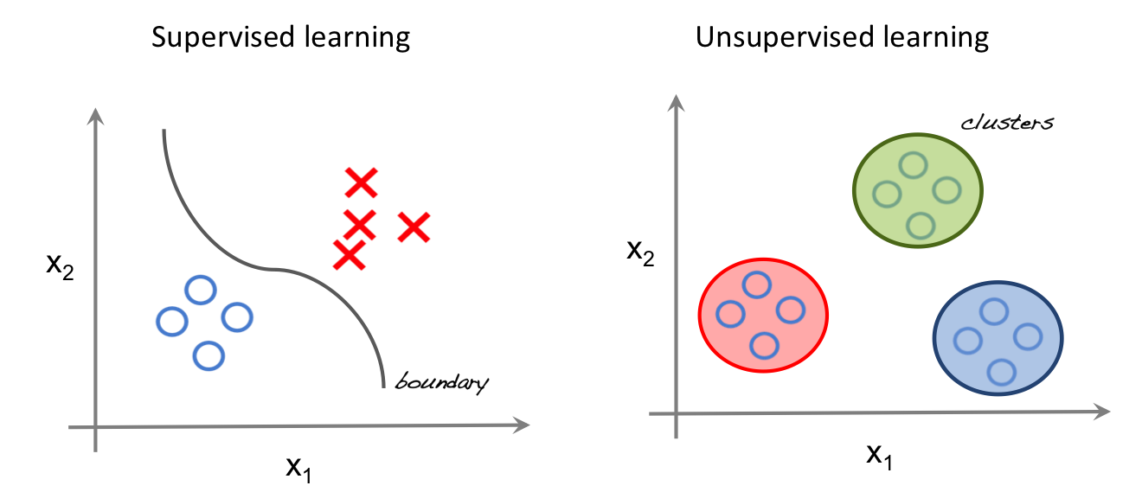
Neural networks overview

Slide 5
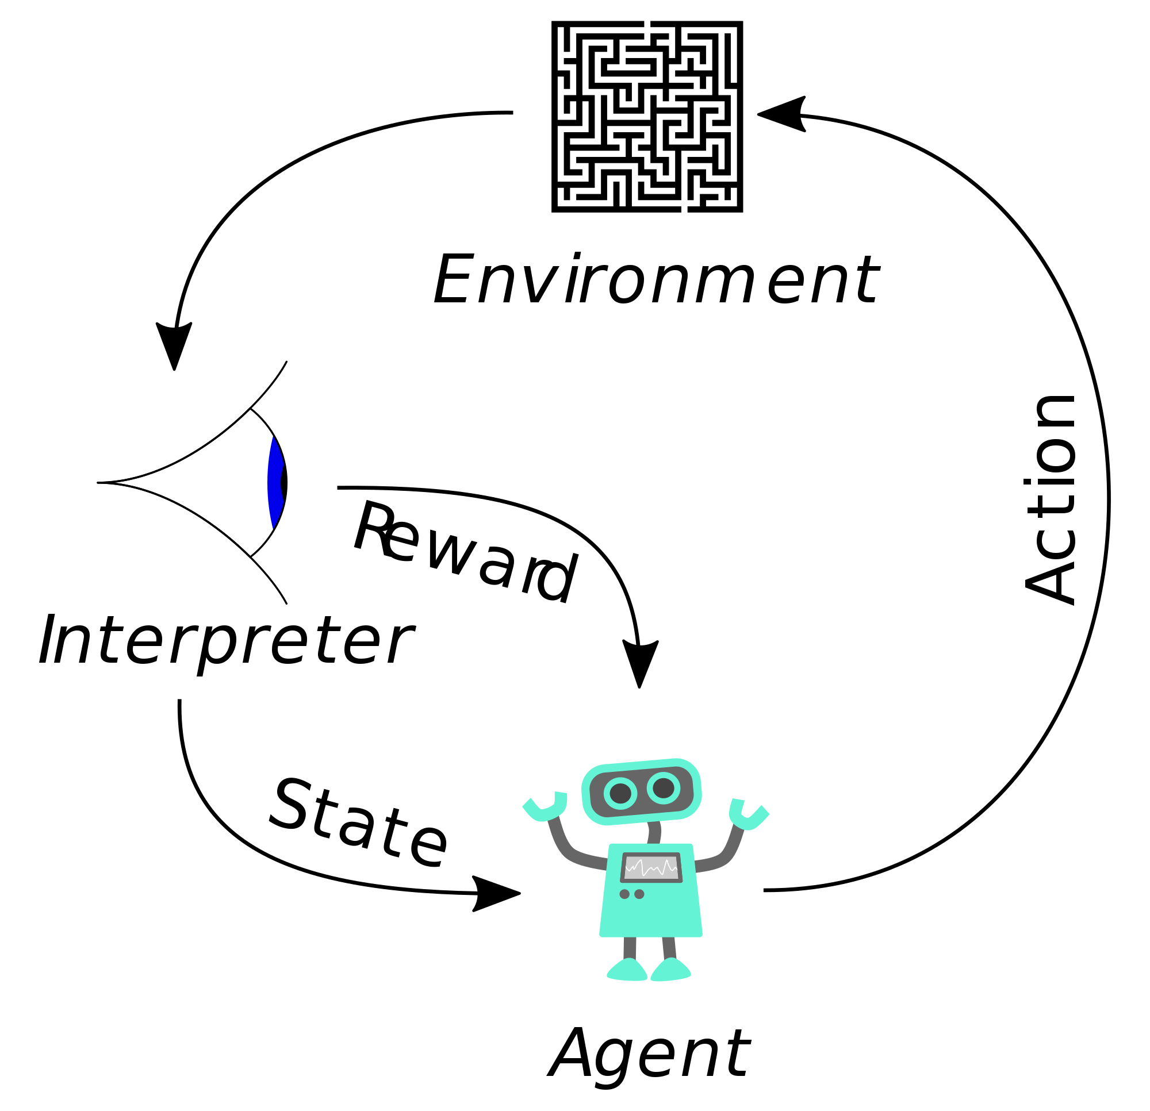
Neural networks overview
Reinforcement Learning

Slide 6
Supervised Learning Models
CNN(Convolutional neural network)
AlexNet VggNet GoggleNet
ResNet DenseNet
RNN(Recurrent neural network)
LSTM, '97.11 GRU, 14.11
ACT: Adaptive Computation Time, '17.05
Capsule Net, '17.10data flow graphs

Slide 7
Unsupervised Learning Models
AE(Auto-encoder)
CVAE, '14.06.20 AAE, '15.11.18
AVB, '17.01.17 VQ-VAE, '17.11.2
GAN(Generative Adversarial Networks)
CGAN, '14.11.06 DCGAN, '15.11.19 infoGAN, '16.06.12
EBGAN, '16.09.11 ACGAN, '16.10.30 WGAN, '17.01.26
BEGAN, '17.02.27 WGAN-GP, '17.03.31 TripleGAN, '17.03.07

Slide 8
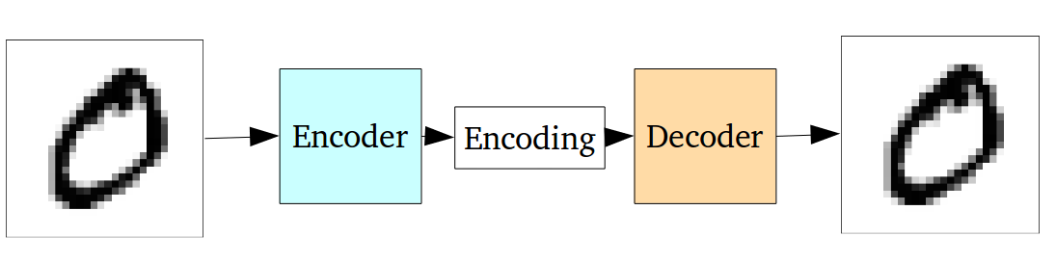
Autoencoder
Two connected networks: an encoder and a decoder
Encode input
Converts into a smaller, dense representation
Cons: Injected noise and imperfect reconstruction, result is blurred
Notes:
For a framework to be useful in production, it needs to be efficient, scalable, and maintainable. For research, the framework needs to have flexible operations that can be combined in novel ways. Alternative frameworks are either flexible enough for research but less scalable, such as Chainer and PyTorch, or scalable but less flexible, such as Caffe and MXNet. TensorFlow are both flexible and scalable, allowing users to streamline from research into production.

Slide 9
What is GANs
“(GANs), and the variations that are now being proposed is the most interesting idea in the last 10 years in ML, in my opinion.” by Yann LeCun
Notes:
For a framework to be useful in production, it needs to be efficient, scalable, and maintainable. For research, the framework needs to have flexible operations that can be combined in novel ways. Alternative frameworks are either flexible enough for research but less scalable, such as Chainer and PyTorch, or scalable but less flexible, such as Caffe and MXNet. TensorFlow are both flexible and scalable, allowing users to streamline from research into production.

Slide 10

What is GANs
Playing chess:
Compete with an opponent better than you
beat him / her in the next game
repeat this step
defeat the opponent
Notes:
For a framework to be useful in production, it needs to be efficient, scalable, and maintainable. For research, the framework needs to have flexible operations that can be combined in novel ways. Alternative frameworks are either flexible enough for research but less scalable, such as Chainer and PyTorch, or scalable but less flexible, such as Caffe and MXNet. TensorFlow are both flexible and scalable, allowing users to streamline from research into production.

Slide 11
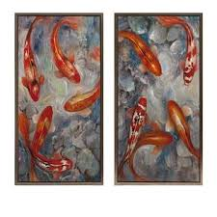
What is GANs
Forger and an investigator:
Forger: create fraudulent imitations
Investigator: catch these forgers who create the fraudulent
contest of forger vs investigator goes on
world class investigators (and unfortunately world class forger)
Notes:
For a framework to be useful in production, it needs to be efficient, scalable, and maintainable. For research, the framework needs to have flexible operations that can be combined in novel ways. Alternative frameworks are either flexible enough for research but less scalable, such as Chainer and PyTorch, or scalable but less flexible, such as Caffe and MXNet. TensorFlow are both flexible and scalable, allowing users to streamline from research into production.

Slide 12
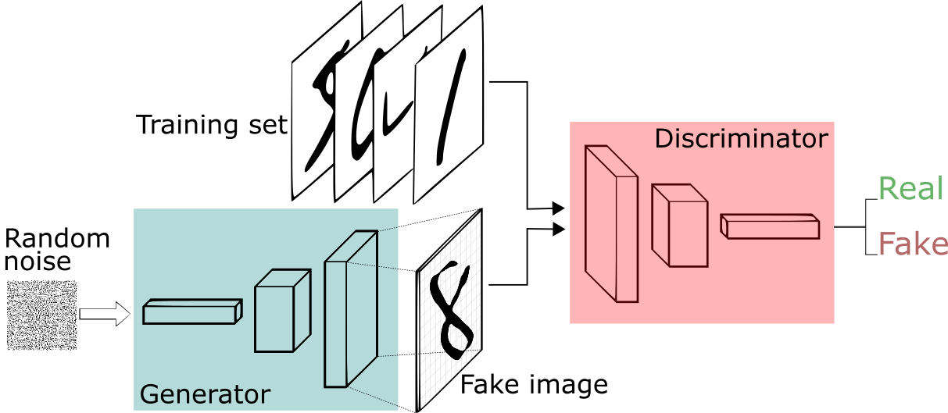
What is GANs
Two main components
Notes:
For a framework to be useful in production, it needs to be efficient, scalable, and maintainable. For research, the framework needs to have flexible operations that can be combined in novel ways. Alternative frameworks are either flexible enough for research but less scalable, such as Chainer and PyTorch, or scalable but less flexible, such as Caffe and MXNet. TensorFlow are both flexible and scalable, allowing users to streamline from research into production.

Slide 13
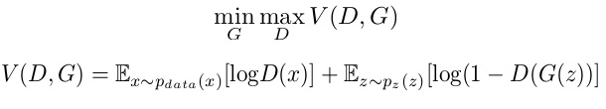
Define GAN
Pdata(x) -> The distribution of real data X -> Sample from pdata(x) P(z) -> Distribution of generator Z -> Sample from p(z) G(z) -> Generator Network D(x) -> Discriminator Network

Slide 14
Define GANs
Entropy of (pdata(x))
data from real distribution
Entropy of (p(z))
data from random input

Slide 15
Define GANs
Max
Min
Discriminator is trying to maximize our function V
Generator is trying to minimize the function V

Slide 16
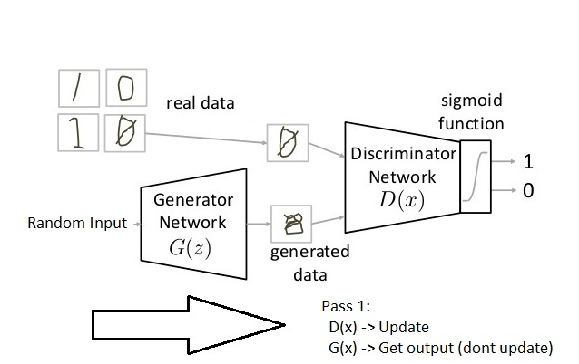
Training GAN
Pass 1: Freeze generator, Training discriminator

Slide 17
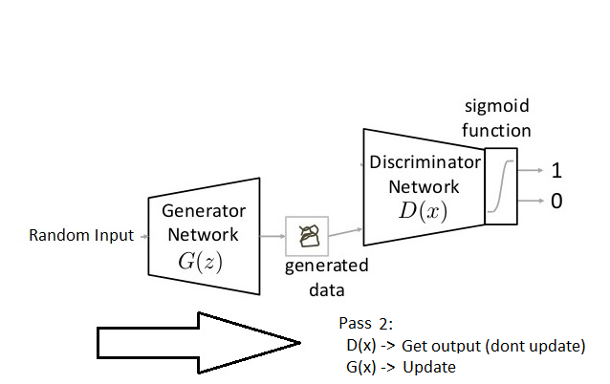
Training GAN
Pass 2: freeze discriminator, Train generator

Slide 18
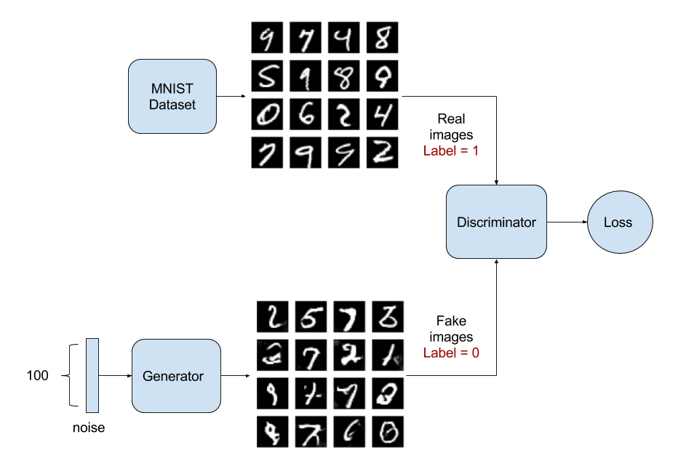
GANs project: Define problem
Generate fake images
MNIST Dataset Overview
60,000 examples for training
10,000 examples for testing.
28x28 pixels with values from 0 to 1.
Flattened 1-D array of 784 features (28*28)
Notes:
For a framework to be useful in production, it needs to be efficient, scalable, and maintainable. For research, the framework needs to have flexible operations that can be combined in novel ways. Alternative frameworks are either flexible enough for research but less scalable, such as Chainer and PyTorch, or scalable but less flexible, such as Caffe and MXNet. TensorFlow are both flexible and scalable, allowing users to streamline from research into production.

Slide 19
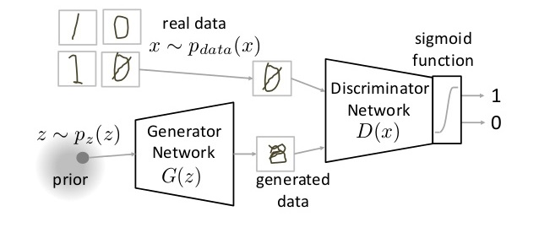
GANs project: Define architecture
One hidden layer for discriminator
One hidden layer for generator
Notes:
For a framework to be useful in production, it needs to be efficient, scalable, and maintainable. For research, the framework needs to have flexible operations that can be combined in novel ways. Alternative frameworks are either flexible enough for research but less scalable, such as Chainer and PyTorch, or scalable but less flexible, such as Caffe and MXNet. TensorFlow are both flexible and scalable, allowing users to streamline from research into production.

Slide 20
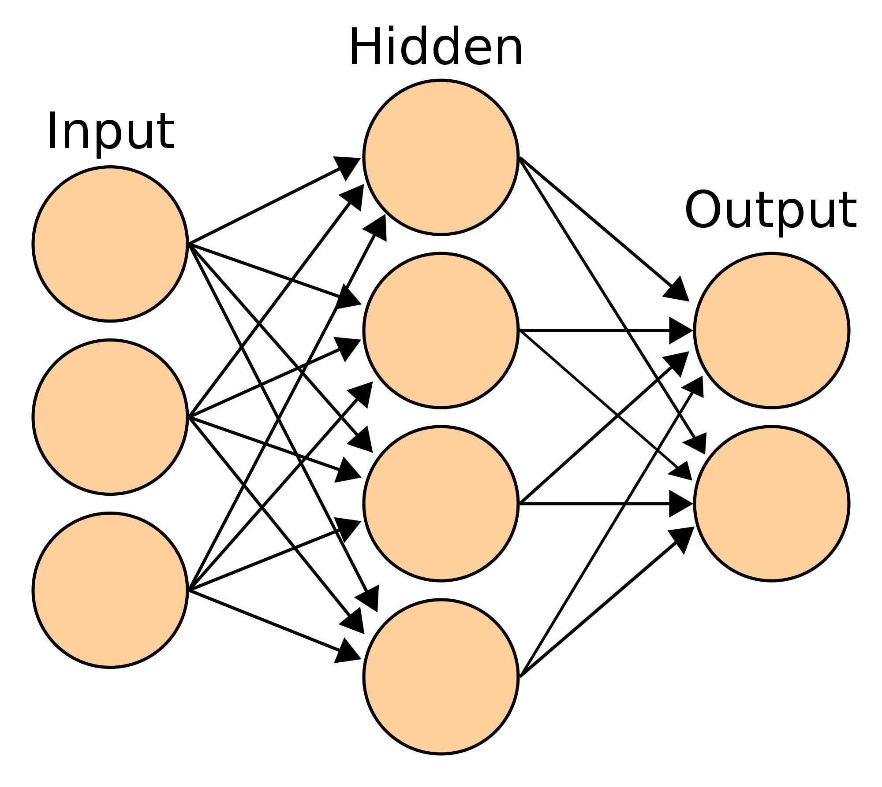
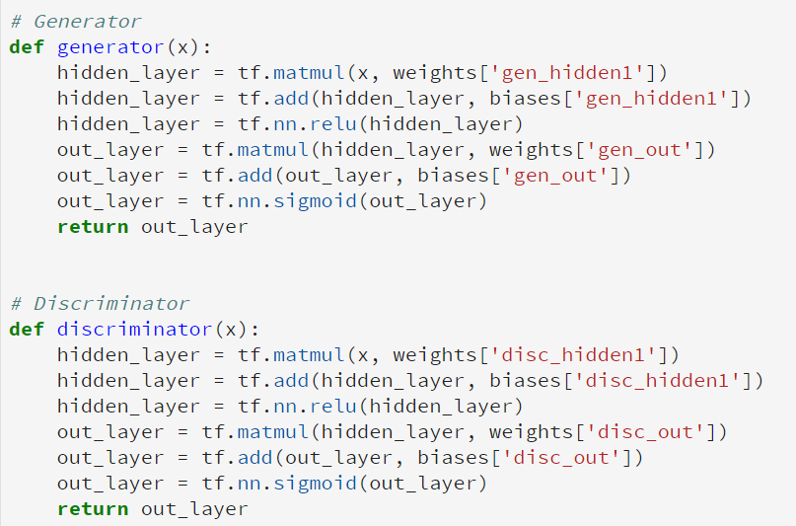
GANs project: Define architecture
One hidden layer for discriminator
One hidden layer for generator
Notes:
For a framework to be useful in production, it needs to be efficient, scalable, and maintainable. For research, the framework needs to have flexible operations that can be combined in novel ways. Alternative frameworks are either flexible enough for research but less scalable, such as Chainer and PyTorch, or scalable but less flexible, such as Caffe and MXNet. TensorFlow are both flexible and scalable, allowing users to streamline from research into production.

Slide 21
GANs project: Training
Train Discriminator on real data for n epochs
Generate fake inputs for generator
Train discriminator on fake data
Train generator with the output of discriminator
Repeat 1-4 steps
Check fake data result
Notes:
For a framework to be useful in production, it needs to be efficient, scalable, and maintainable. For research, the framework needs to have flexible operations that can be combined in novel ways. Alternative frameworks are either flexible enough for research but less scalable, such as Chainer and PyTorch, or scalable but less flexible, such as Caffe and MXNet. TensorFlow are both flexible and scalable, allowing users to streamline from research into production.

Slide 22
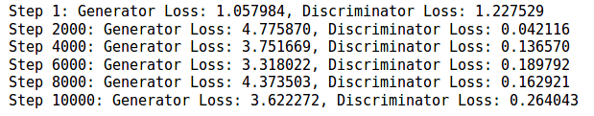
GANs project: Results
Training 10,000 steps
Notes:
For a framework to be useful in production, it needs to be efficient, scalable, and maintainable. For research, the framework needs to have flexible operations that can be combined in novel ways. Alternative frameworks are either flexible enough for research but less scalable, such as Chainer and PyTorch, or scalable but less flexible, such as Caffe and MXNet. TensorFlow are both flexible and scalable, allowing users to streamline from research into production.

Slide 23
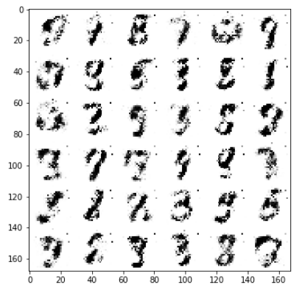
GANs project: Results
Training 10,000 steps
Notes:
For a framework to be useful in production, it needs to be efficient, scalable, and maintainable. For research, the framework needs to have flexible operations that can be combined in novel ways. Alternative frameworks are either flexible enough for research but less scalable, such as Chainer and PyTorch, or scalable but less flexible, such as Caffe and MXNet. TensorFlow are both flexible and scalable, allowing users to streamline from research into production.

Slide 24
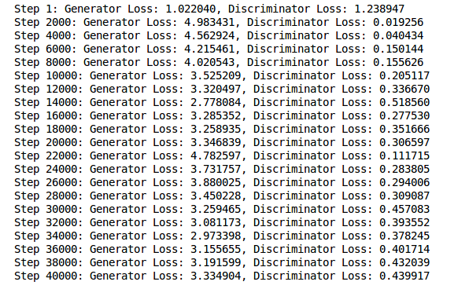
GANs project: Results
Training 40,000 steps
Notes:
For a framework to be useful in production, it needs to be efficient, scalable, and maintainable. For research, the framework needs to have flexible operations that can be combined in novel ways. Alternative frameworks are either flexible enough for research but less scalable, such as Chainer and PyTorch, or scalable but less flexible, such as Caffe and MXNet. TensorFlow are both flexible and scalable, allowing users to streamline from research into production.

Slide 25
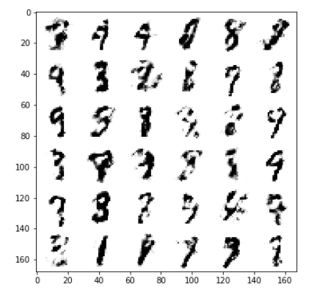
GANs project: Results
Training 40,000 steps
Notes:
For a framework to be useful in production, it needs to be efficient, scalable, and maintainable. For research, the framework needs to have flexible operations that can be combined in novel ways. Alternative frameworks are either flexible enough for research but less scalable, such as Chainer and PyTorch, or scalable but less flexible, such as Caffe and MXNet. TensorFlow are both flexible and scalable, allowing users to streamline from research into production.

Slide 26
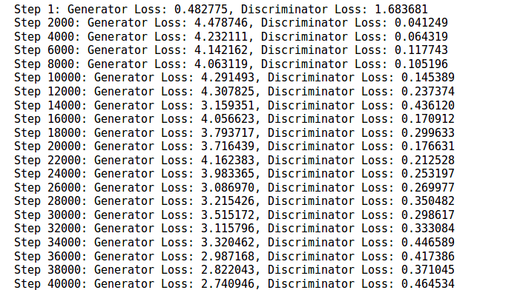
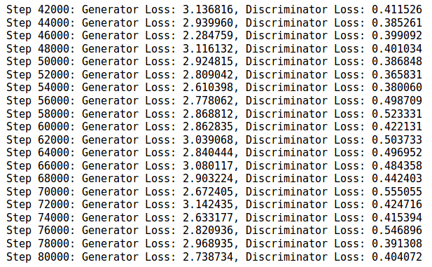
GANs project: Results
Training 80,000 steps
Notes:
For a framework to be useful in production, it needs to be efficient, scalable, and maintainable. For research, the framework needs to have flexible operations that can be combined in novel ways. Alternative frameworks are either flexible enough for research but less scalable, such as Chainer and PyTorch, or scalable but less flexible, such as Caffe and MXNet. TensorFlow are both flexible and scalable, allowing users to streamline from research into production.

Slide 27
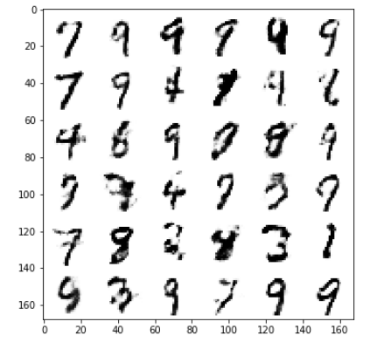
GANs project: Results
Training 80,000 steps:
Notes:
For a framework to be useful in production, it needs to be efficient, scalable, and maintainable. For research, the framework needs to have flexible operations that can be combined in novel ways. Alternative frameworks are either flexible enough for research but less scalable, such as Chainer and PyTorch, or scalable but less flexible, such as Caffe and MXNet. TensorFlow are both flexible and scalable, allowing users to streamline from research into production.

Slide 28
GANs project: Analysis
200th step →
Notes:
For a framework to be useful in production, it needs to be efficient, scalable, and maintainable. For research, the framework needs to have flexible operations that can be combined in novel ways. Alternative frameworks are either flexible enough for research but less scalable, such as Chainer and PyTorch, or scalable but less flexible, such as Caffe and MXNet. TensorFlow are both flexible and scalable, allowing users to streamline from research into production.

Slide 29
GANs project: Analysis
Step based evaluation:
10kth Step
40kth Step
80kth Step
Notes:
For a framework to be useful in production, it needs to be efficient, scalable, and maintainable. For research, the framework needs to have flexible operations that can be combined in novel ways. Alternative frameworks are either flexible enough for research but less scalable, such as Chainer and PyTorch, or scalable but less flexible, such as Caffe and MXNet. TensorFlow are both flexible and scalable, allowing users to streamline from research into production.

Slide 30
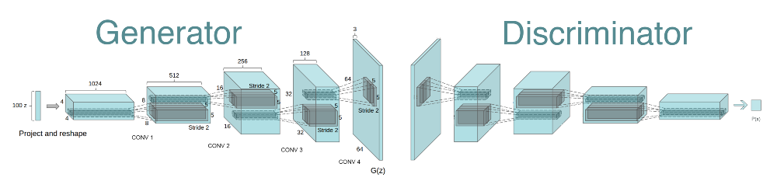
GANs project: DCGAN Deep Convolutional Generative Adversarial Network
Notes:
For a framework to be useful in production, it needs to be efficient, scalable, and maintainable. For research, the framework needs to have flexible operations that can be combined in novel ways. Alternative frameworks are either flexible enough for research but less scalable, such as Chainer and PyTorch, or scalable but less flexible, such as Caffe and MXNet. TensorFlow are both flexible and scalable, allowing users to streamline from research into production.

Slide 31
GANs project: DCGAN Deep Convolutional Generative Adversarial Network
References:
Unsupervised representation learning with deep convolutional generative adversarial networks. A Radford, L Metz, S Chintala, 2016.
Understanding the difficulty of training deep feedforward neural networks. X Glorot, Y Bengio. Aistats 9, 249-256
Batch Normalization: Accelerating Deep Network Training by Reducing Internal Covariate Shift. Sergey Ioffe, Christian Szegedy. 2015.
Notes:
For a framework to be useful in production, it needs to be efficient, scalable, and maintainable. For research, the framework needs to have flexible operations that can be combined in novel ways. Alternative frameworks are either flexible enough for research but less scalable, such as Chainer and PyTorch, or scalable but less flexible, such as Caffe and MXNet. TensorFlow are both flexible and scalable, allowing users to streamline from research into production.

Slide 32
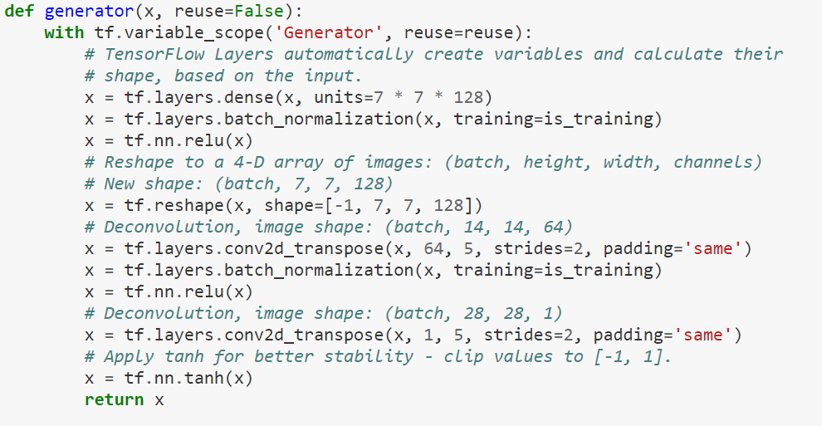
GANs project: DCGAN Deep Convolutional Generative Adversarial Network
Notes:
For a framework to be useful in production, it needs to be efficient, scalable, and maintainable. For research, the framework needs to have flexible operations that can be combined in novel ways. Alternative frameworks are either flexible enough for research but less scalable, such as Chainer and PyTorch, or scalable but less flexible, such as Caffe and MXNet. TensorFlow are both flexible and scalable, allowing users to streamline from research into production.

Slide 33
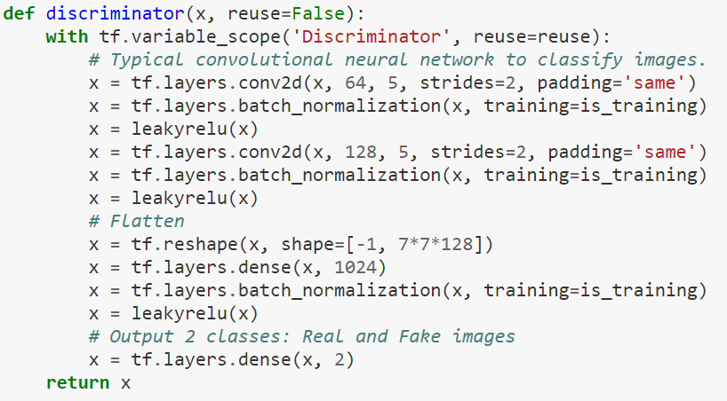
GANs project: DCGAN Deep Convolutional Generative Adversarial Network
Notes:
For a framework to be useful in production, it needs to be efficient, scalable, and maintainable. For research, the framework needs to have flexible operations that can be combined in novel ways. Alternative frameworks are either flexible enough for research but less scalable, such as Chainer and PyTorch, or scalable but less flexible, such as Caffe and MXNet. TensorFlow are both flexible and scalable, allowing users to streamline from research into production.

Slide 34
GANs project: Analysis
100th step →
Notes:
For a framework to be useful in production, it needs to be efficient, scalable, and maintainable. For research, the framework needs to have flexible operations that can be combined in novel ways. Alternative frameworks are either flexible enough for research but less scalable, such as Chainer and PyTorch, or scalable but less flexible, such as Caffe and MXNet. TensorFlow are both flexible and scalable, allowing users to streamline from research into production.

Slide 35
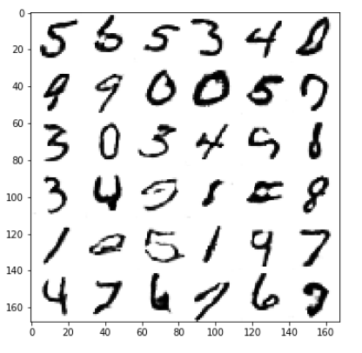
GANs project: Analysis
Step based evaluation:
GAN 10k
GAN 40k
GAN80k
DCGAN 10k
Notes:
For a framework to be useful in production, it needs to be efficient, scalable, and maintainable. For research, the framework needs to have flexible operations that can be combined in novel ways. Alternative frameworks are either flexible enough for research but less scalable, such as Chainer and PyTorch, or scalable but less flexible, such as Caffe and MXNet. TensorFlow are both flexible and scalable, allowing users to streamline from research into production.

Slide 36

GANs project: Analysis
This is the end
Notes:
For a framework to be useful in production, it needs to be efficient, scalable, and maintainable. For research, the framework needs to have flexible operations that can be combined in novel ways. Alternative frameworks are either flexible enough for research but less scalable, such as Chainer and PyTorch, or scalable but less flexible, such as Caffe and MXNet. TensorFlow are both flexible and scalable, allowing users to streamline from research into production.

